Slide 1
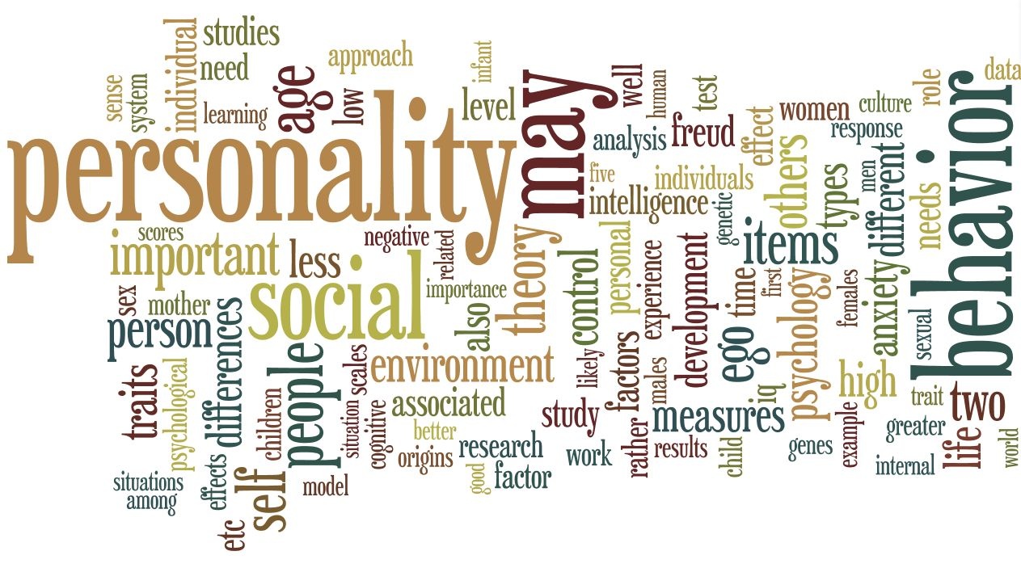

Slide 2






L1: Birth or Upbringing?
CCCA3

Slide 3
Learning outcomes
By the end of the session, you will be able to:
Recognize and employ personality adjectives
Relate birth order to personalities
Reinvest the target language in speaking
2

Slide 4
Outline
Personality characteristics
01
What is personality?
Personality adjectives
Birth order theory
02
What is birth order?
Birth order theory
Birth order and personalities
Vocabulary practice
03
3

Slide 5
Outline
Birth order and career success
04
How does birth order impact career success
The Pygmalion effect
Birth order and health
05
Birth order can predict health
3

Slide 6
1. Personality characteristics
4

Slide 7
What is personality?
?
Personality is a relatively stable set of characteristics that influences an individual's behavior.
Personality traits reflect people's characteristic patterns of thoughts, feelings, and behaviours.
In addition to this, personality arises from within the individual and remains fairly consistent throughout life.

Slide 8
Do you think we are born with our personalities, or do we develop them because of what happens to us?

Slide 9
What adjectives best describe your personality?

Slide 10


The adjectives below describe personality.
Divide them into positive or negative.
Affable
Gregarious
Quick-tempered
Resentful
Versatile
Over-critical
Exuberant
Truculent
Courteous
Cynical

Slide 11
Industrious | Hostile
independent | Enigmatic
ambitious | power-oriented
Altruistic | Mean
Gifted | Envious

Slide 12

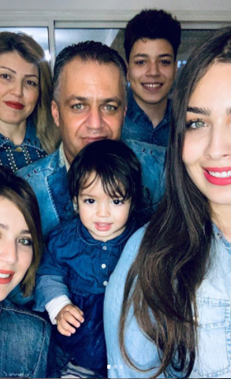
Do you have siblings? Or have you ever been categorized based on your birth order even if you are the dearest single child of your parents? Do you and your siblings, always fight? Or else you share a strong bond of love? Does it affect our psychology anyway?
Yes, these birth order traits can change and impact on our psychology, thus personality!
12

Slide 13
2. Birth order theory
13

Slide 15

“Birth order is the chronological order of sibling births in a family.“
http://www.healthofchildren.com/B/Birth-Order.html#ixzz6YDMtagxS
The theory about birth order is that depending on your birth placement, your birth order, there seems to be a correlation between that and aspects of your personality.
It is the idea that the order in which we’re born into a family affects our individual personalities.
14

Slide 16
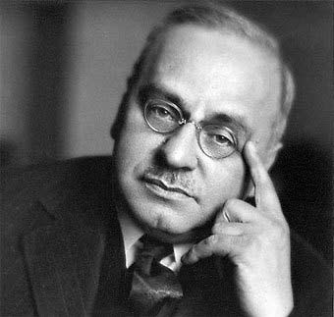
The Birth Order Theory
01
Suspected by Alfred Adler, a 19th- and early 20th-century, Austrian psychotherapist.
02
Suggests that birth order leads to differences in personality traits of siblings.
03
Has not been proven scientifically.
04
Received criticisms: influences certain temporary aspects of personality.

Slide 17



What personality characteristics do you associate with the different birth order of children in a family:
the oldest child?
the middle child?
the youngest child?
or an only child?
1
2
3

Slide 18
First Born Child:
The oldest child tends to be conservative, power-oriented, and predisposed toward leadership. Because they often take responsibility for their younger siblings, firstborns grow up to be caring, more willing to become parents, and more likely to take initiative.

Slide 19
First born’s characteristics
Natural leader
High achiever
Organized
On-time
Know it all
Bossy
Responsible
Obeys the rules
17

Slide 20
The second (middle) child:
They often struggle to surpass their older sibling. The pace of development is higher. The middle kids in a family often tend to be ambitious, but they are rarely selfish.
They are also more likely to set unreasonably high goals for themselves. This increases the number of failures, however knowing how to cope with difficulties in life is what makes them stronger.

Slide 21
Second born’s characteristics
Flexible
Easy-going
Social
Peacemaker
Independent
Secretive
Strong negotiator
Generous
May feel life is unfair
Source: rebelcircus.com
18

Slide 22
Last Born Child:
As a rule, the youngest child gets a lot of care and attention from parents and even older siblings. That is why they may feel less experienced and independent.
Last-borns are usually highly motivated to surpass their older sisters and brothers. Very often they achieve a big success and earn recognition in their chosen field.

Slide 23
Last born’s characteristics
Risk-taker
Outgoing
Creative
Self-centered
Financially irresponsible
Competitive
Bored easily
Humorous
Likes to be pampered
Source: rebelcircus.com
19

Slide 24
The Only Child:
Without any siblings to compete with, the only child often competes with his or her father.
Being overly pampered by their parents, the single kid expects pampering and protection from all others too.

Slide 25
Only child’s characteristics
Self-controlled
Leader
Mature
Dependable
Demanding
Unforgiving
Private
Sensitive
Close to parents
Source: rebelcircus.com
20

Slide 26

Twins/Multiples
Merged personalities
Troublemakers
telepathic or para-psychological connection

Slide 27
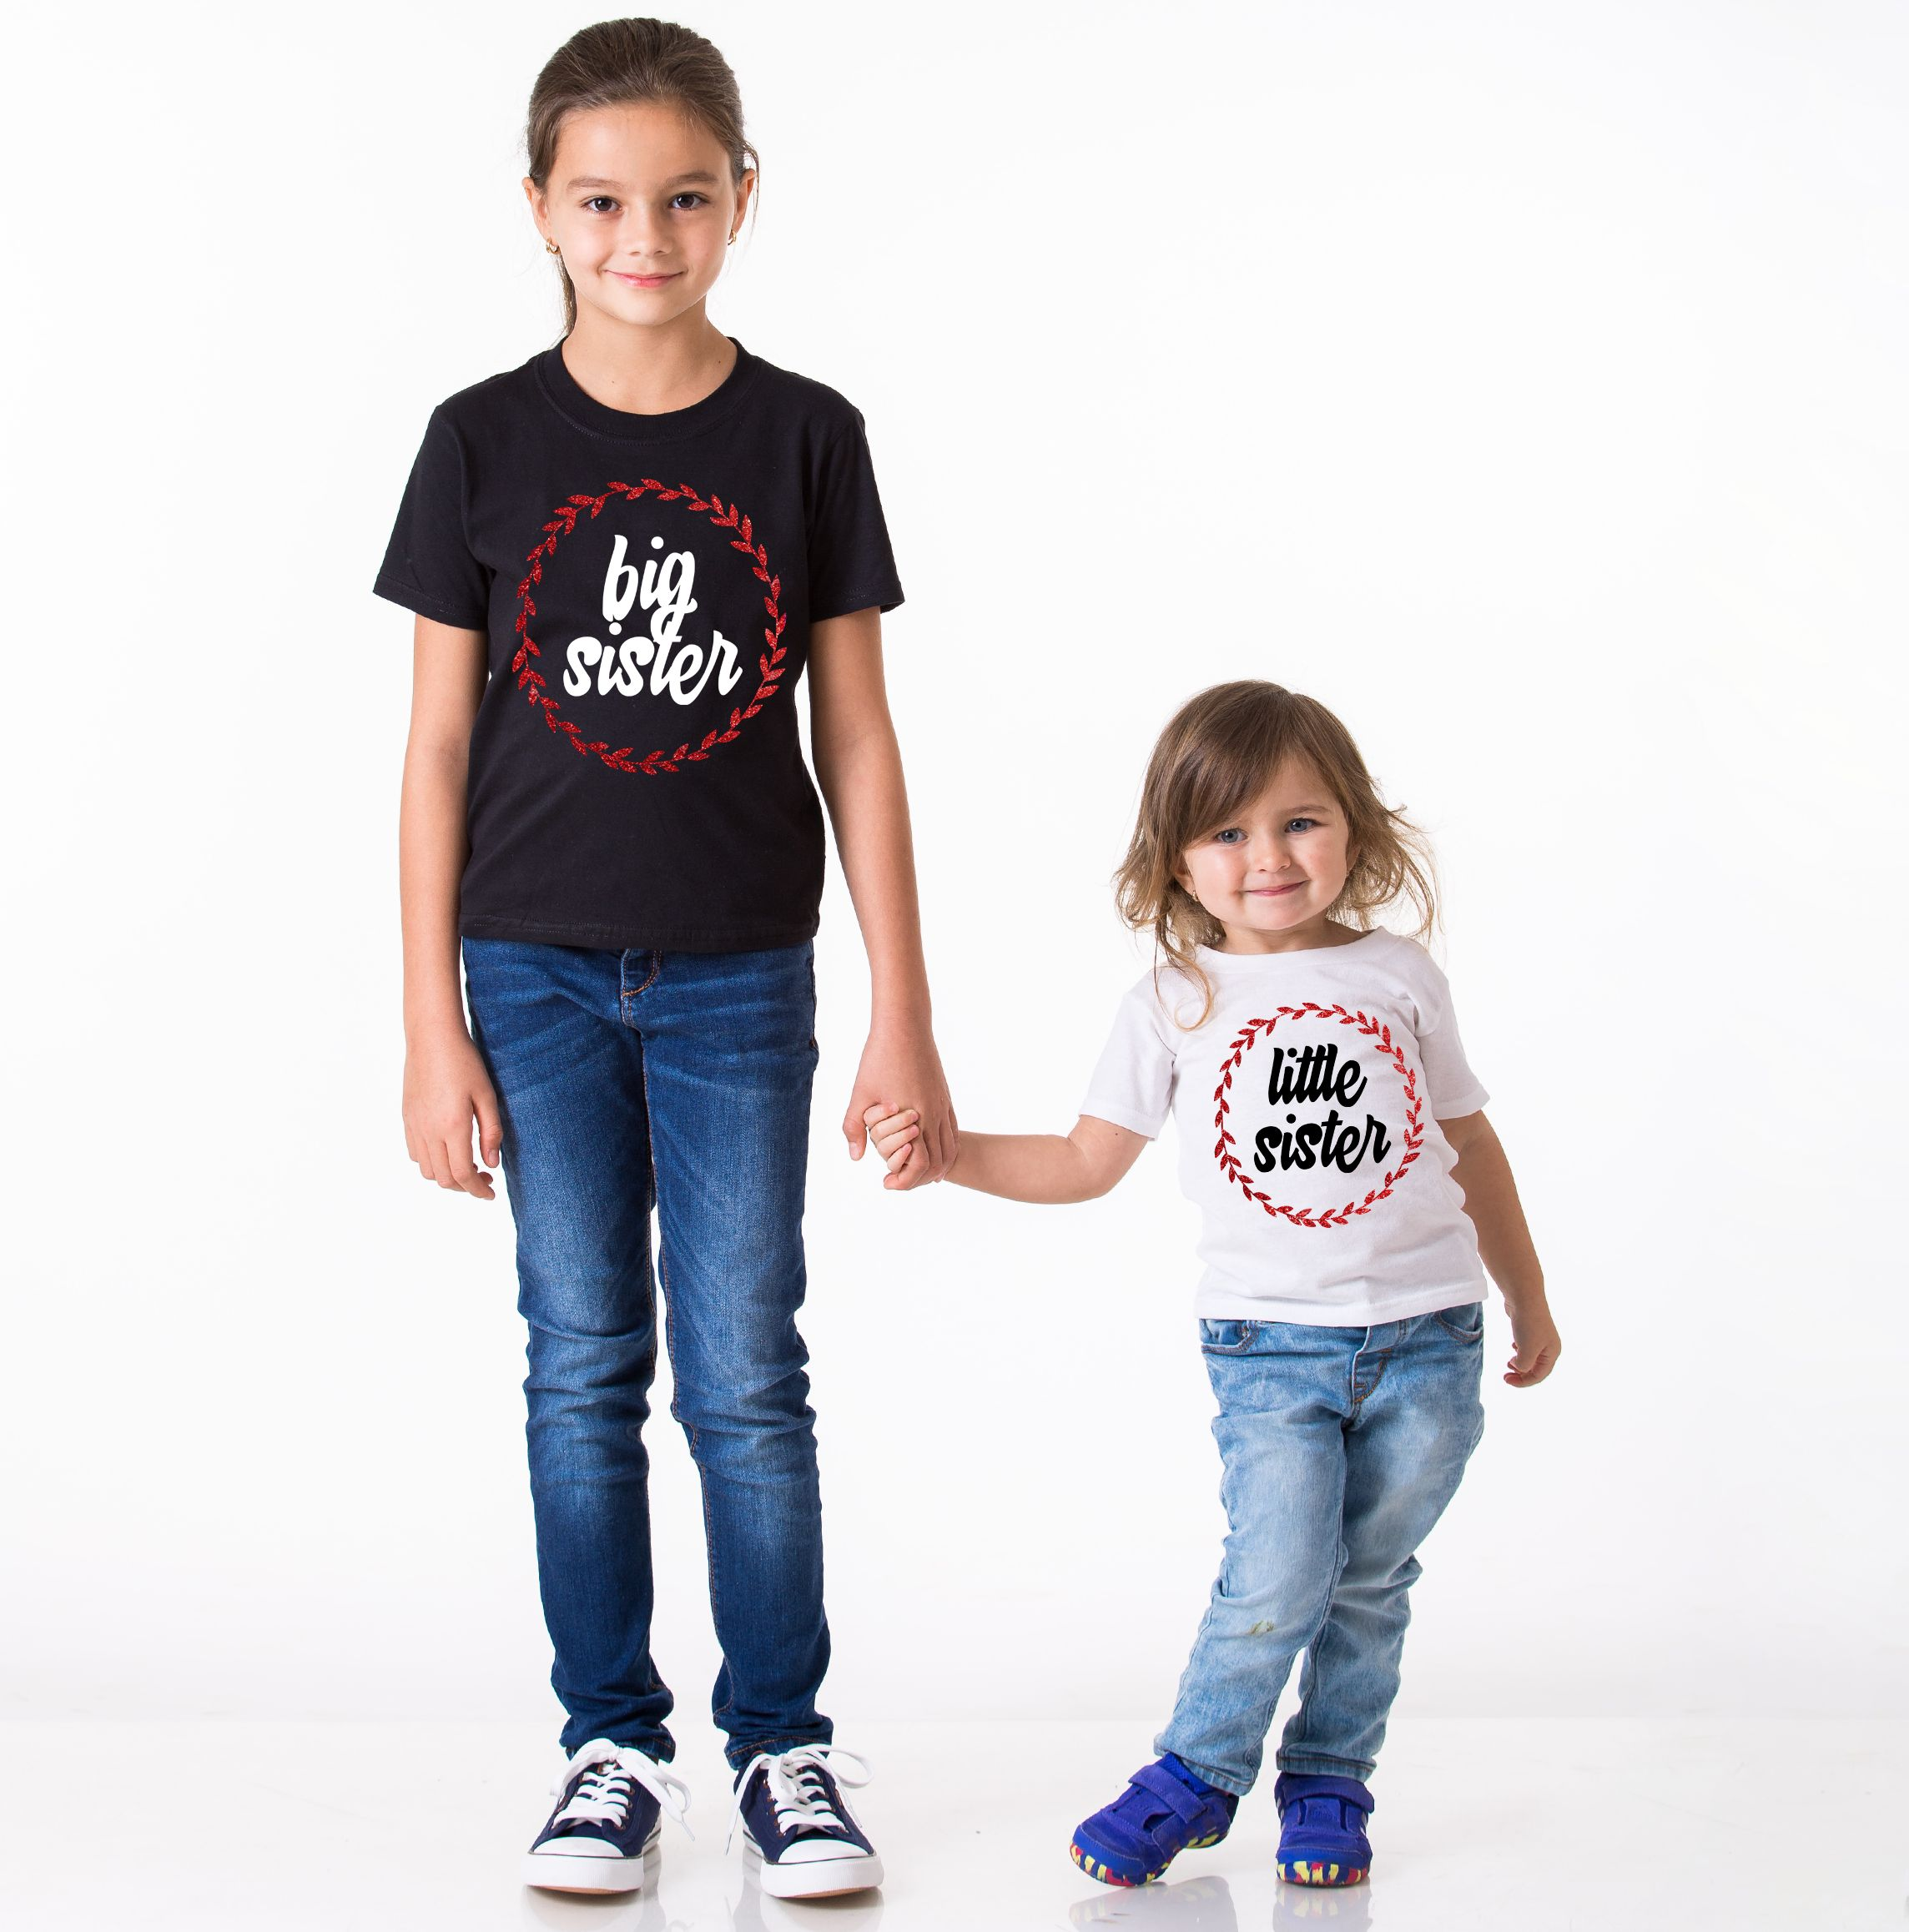


Can you guess the birth order?
Attention-seeking friend
middle-child syndrome
Entitled little sister
She’s the baby of family—of course she needs a window seat
Spread-too-thin aunt
As the oldest child, she thinks she has to take care of everyone and everything!

Slide 28
Research indicates that:
the number one factor influencing personality is birth order, making the person unique.
While other factors, such as age, race, and gender play a role in shaping personality.
Birth order also influences beliefs, outlook, and overall well-being.

Slide 29
What shapes personality development?
Personality: the total of behaviors, attitudes, beliefs, and values that are characteristic of an individual.
1. Determines how we adjust to our environment.
2. Determines how we react in certain situations.
3. No two individuals are the same.
Nature vs. Nurture (inherited characteristics vs. environmental/ social learning)
1. Heredity: the transmission of genetic characteristics from parents to children.
2. Instinct: unchanging, biologically inherited pattern.
3. Social environment and learning. Most Social scientists believe that environmental or nurture has the greatest influence. (Pavlov & dogs salivate).

Slide 30
Four main factors which determine Personality:
1. Heredity: What you are born with can also include certain aptitudes: a capacity to learn a particular skill like art or music.
2. Birth Order: Our personalities are also influenced by whether we have brothers, sisters, both, or neither. Birth order can affect views of the world.
3. Parental Characteristics: for example; age of parents can have an effect on children’s development. Also; level of education, religious orientation, economic status, cultural heritage, and occupation.
4. Cultural Environment: determines basic types of personalities that will be found in a society. Each culture has model personality types; I.e. U.S. = competitiveness, assertiveness, and individualism

Slide 31
True or False
An individual’s personality is based on his or her genetic makeup, intelligence, and knowledge.
True
People’s families, experiences, and interactions with others play a large role in shaping personality
False
Children develop basic skills as a natural part of physical development
True
Children need contact with other people to learn to model and develop basic skills
False

Slide 32
3. Vocabulary practice
22

Slide 33
Match the personality adjectives with their descriptions.
Aloof
Not friendly or forthcoming
Aloof
Stubborn
Certain about their beliefs and expresses their ideas strongly
Determined
Opinionated
Wanting to do something very much and being resistant to difficulties
Opinionated
Determined
Having dogged determination not to change one's attitude or position on something
Stubborn
23

Slide 34
Fill in the blanks with the appropriate personality adjective.
Women tend to be more _______ than men at wearing a seatbelt.
I’ve just decided I was a bit too _______ to be a doctor.
Make me thoughtful but not moody: helpful but not _______.
Billionaires are usually fairly _______ about the exact amount that they're worth.
She has always been very _______ and she's got many of friends!
Sarah needs someone _______ to take care of the children while being at work.
conscientious
Extrovert
bossy
conscentious
dependable
secretive
frivolous
frivolous
bossy
secretive
extrovert
dependable
25

Slide 35
More adjectives that can be used to describe aspects of someone's personality based on big five traits.
Sample Personality Adjectives
Personality Trait | Positive Adjectives | Negative Adjectives
Extroversion | outgoing, talkative, social, friendly, lively, active, fun | shy, reserved, quiet, timid, antisocial, withdrawn
Openness | open-minded, receptive, nonjudgmental, flexible, curious | narrow-minded, rigid, stubborn, judgmental, discriminating
Conscientiousness | hardworking, punctual, thoughtful, organized, careful, cautious, obedient, responsible | lazy, flaky, careless, reckless, irresponsible, negligent, rash
Neuroticism | patient, optimistic, easygoing, calm, self-assured, stable, reasonable | impatient, pessimistic, brooding, anxious, sensitive, moody, insecure
Agreeableness | good-natured, forgiving, amenable, genial, consenting, generous, cheerful, cooperative | disagreeable, ill-tempered, irritable, rude, spiteful, bitter, uncooperative
27

Slide 36
Choose the word that makes most sense. Discuss if you agree with the statements.
a) An/A honest/generous person can’t work in sales.
b) You don’t need to be lazy/friendly to work well in a team.
c) A responsible/shy person can’t be an actor.
d) You can’t be a CEO of a company if you are too kind/confident.

Slide 37
Look at the situations below and say what each person does or how they feel. Some of the answers might be the same/similar.
a) A boss gives you a new task on Friday evening.
1) A hard-working person does the task at the weekend.
2) A rude person…
3) A clever person…
b) A friend asks you to help them move at the weekend.
1) A lazy person…
2) A helpful person…
3) A polite person…

Slide 38
c) A teacher asks someone from a class to create a presentation.
1) A shy person…
2) A responsible person…
3) A confident person…
d) A person on the street asks for money to buy food.
1) A kind person…
2) A generous person…
3) A creative person…
e) You have to make small talk with someone you don’t know.
1) A confident person…
2) A talkative person…
3) A quiet person…

Slide 39

Birth order and career success!
28

Slide 40

What do Oprah Winfrey, Jeff Bezos and Steve Jobs have in common?

Slide 41
Besides being billionaire moguls, they share something that goes back, way back: “their birth order”.
Winfrey, Bezos and Jobs were all born the “oldest” of their siblings!

Slide 42

4

Slide 43
“There’s an interesting 2017 study out of Sweden that found first-born children are more likely to be managers, and later-born children are more likely to be entrepreneurs.”
Another study “found that first-borns tend to have a higher IQ, which played well in the media and got a lot of shares from first-borns”

Slide 44
In the study of birth order, two models dominate.
Based on these models, firstborns should be more likely to pursue scientific careers, attain higher levels of education, more prestigious careers, and a higher income, whereas later-born individuals should be more likely to pursue artistic and more creative careers.

Slide 45
Is there truth to birth order theory and how it impacts career success?
4

Slide 46
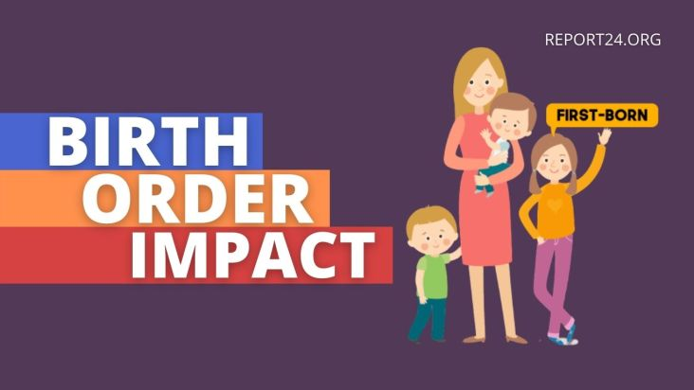
There’s a lot of variation in how someone experiences their place in the sibling constellation. An oldest child with two younger siblings all born within five years of each other will have a very different experience than an oldest child with two siblings born ten years later.
A younger sibling with reliable caregivers is going to have a very different experience than a younger sibling who finds themselves taking on typically adult worries and responsibilities from a young age.
Therefore, the evidence just isn’t there to make sweeping generalizations about the impact of birth order on career success.

Slide 47
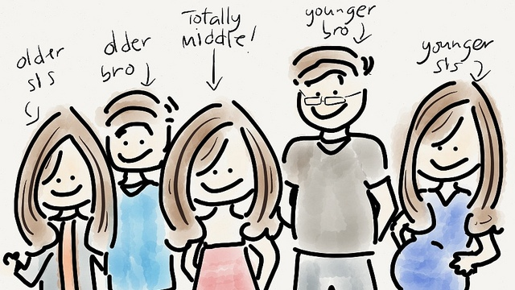
In fact, the psychotherapist agrees that the family we grow up in—from the pre-natal environment, to early relationships with our caregivers, to where our family lives, to who are siblings are—shapes who we are and who we become. “Birth order makes a difference, but it is only one factor of our family experience and our life experience.
The way birth order impacts career, according to research, pales in comparison to other factors like gender, or what zip code we were born in.

Slide 48
Taking what we know about birth order theory, there’s definitely a chance that being first-born children had an impact on these billionaires’ career successes.
Perhaps it lit the fire under their seats in the first place.
But we also know that these icons had wildly different upbringings, families, experiences and strengths that would color their paths from birth to mogul status.
“Nothing is set in stone—we can rewrite our stories any time.”

Slide 49
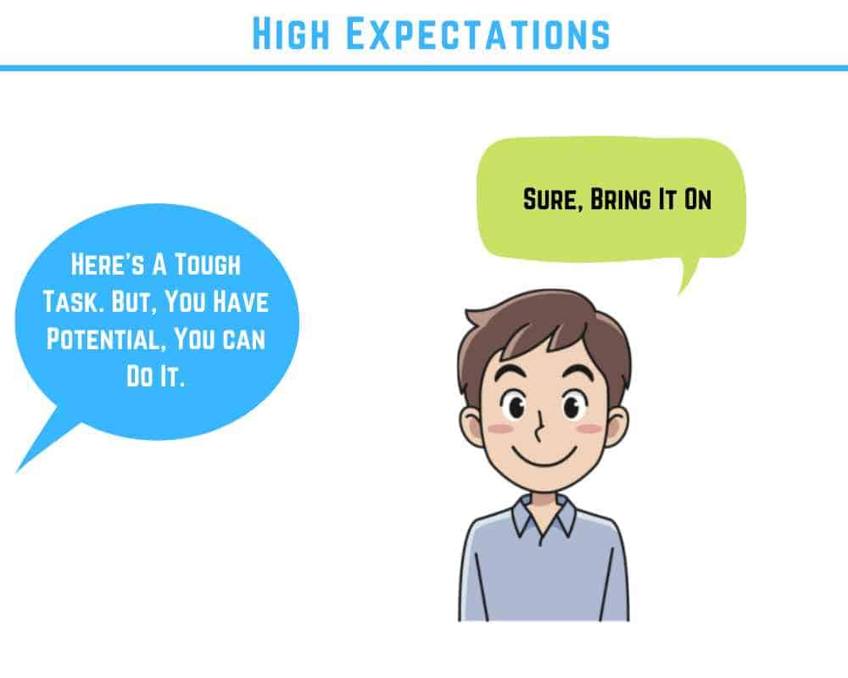
If we categorize ourselves as leadership-oriented first-borns or entrepreneurial last-borns, it impacts how we see ourselves and how we play into those perceived traits.
There’s also the Pygmalion Effect, where expectations from others—like caregivers and teachers—impact what we achieve. If you have a parent in your life who thinks you’re going to be the president, that could drastically impact your self-confidence compared to a child whose family doesn’t think they’re college-bound.

Slide 50

The Pygmalion Effect
The Pygmalion effect is a psychological phenomenon that describes how expectations can modify behavior. It provides evidence for the self-fulfilling prophecy, which is based on the idea that others' beliefs about us become true because their belief impacts how we behave.

Slide 51
How can a person use what they've learned growing up to find success in the workplace?
4

Slide 52
Start with strengths related your career, but also go back to the strengths you showed in your family:
A prototypical eldest child will have some leadership skills.
A prototypical youngest child will know how to march to the beat of their own drum.
A prototypical middle child will be a great peacemaker.
Identify the strengths you showed even as youth in your family and use them when you’re serving tables, managing a team or preparing a presentation.
These strengths may feel so natural to you that you dismiss them. Don’t. These are valuable tools in your career toolbox.

Slide 53
Another interesting study found strong links between birth order and career choice:
The research conducted over the last month has shown that birth order is a significant factor in determining employment role types between siblings.

Slide 54
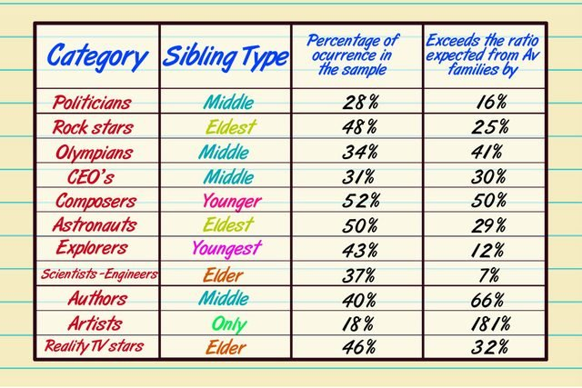

Slide 55
Can Birth Order Predict Your Health?
22

Slide 56
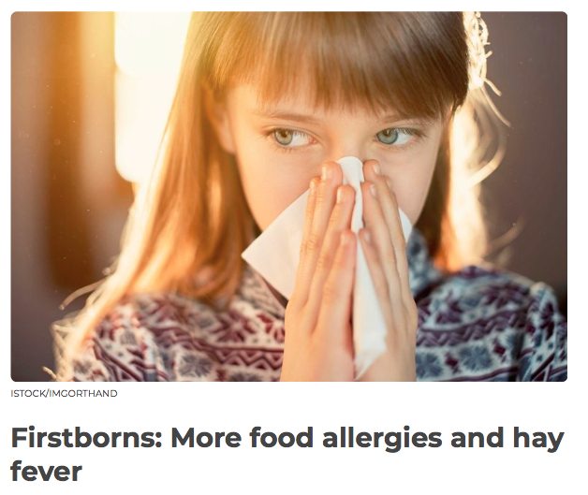
the oldest siblings were more likely to have hay fever and food allergies than their younger brothers and sisters
2

Slide 57

first-born children had less sensitivity to the hormone insulin (a precursor to diabetes) and slightly higher blood pressure compared to later children.

Slide 58

Middle children have a 5 percent lower risk of gum disease,

Slide 59
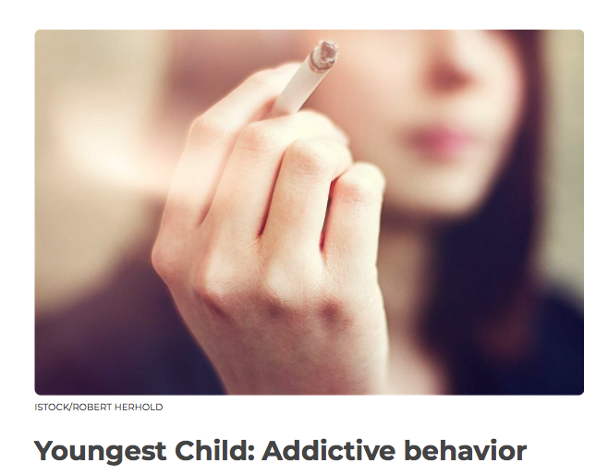
later-borns were more likely to die of respiratory-related cancers than older siblings. The researchers suspect this may be because younger siblings begin smoking at a younger age, which can promote a long-term habit.

Slide 60
Birth order and mental health
22

Slide 61

Adler considered firstborns to be more “neurotic,” a term used to describe anxious but not psychotic symptoms.
More recently, researchers have examined the relationship between birth order and mental health conditions
A research found that the youngest children had the lowest rate of mental health challenges, including emotional, conduct, and attention problems. Youngest children also scored higher on prosocial behavior and resilience. Middle children had the lowest happiness scores across all groups.

Slide 62
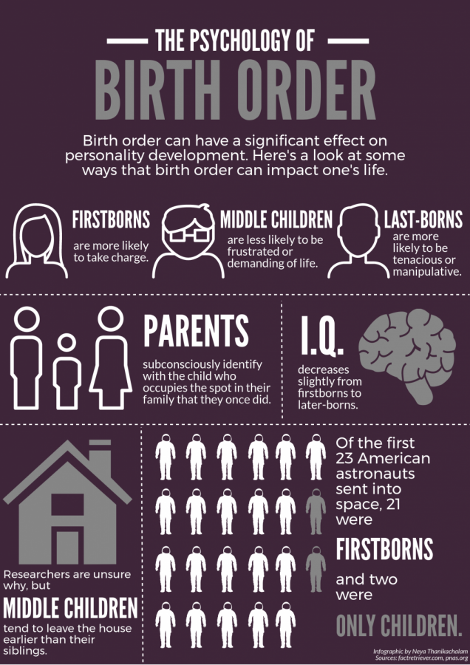

Slide 63
Let’s recap!
22

Slide 64
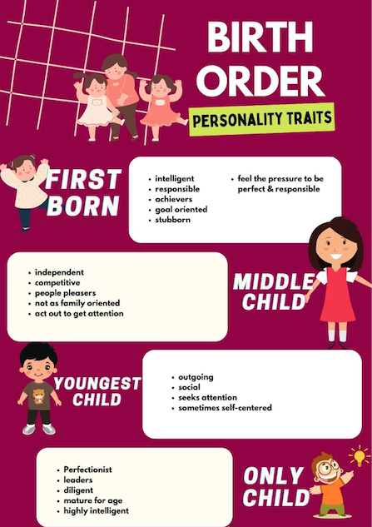


Slide 65
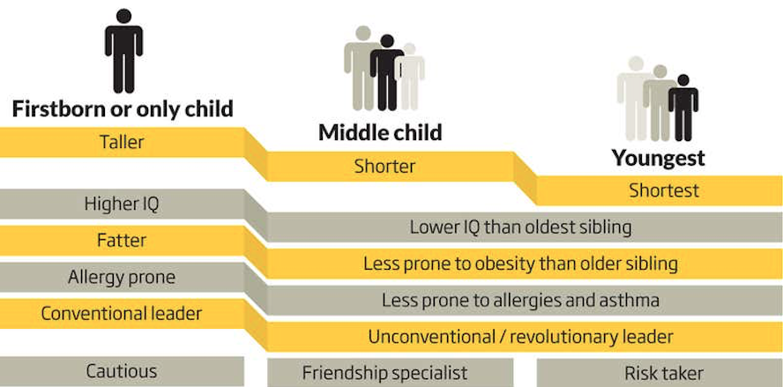

Slide 66
Birth order theory, originally created by Alfred Adler over a hundred years ago, is an interesting theory that suggests your birth order plays a large role in your personality development.
While birth order may sometimes influence personality traits, no one factor can definitively explain them fully. Many interrelated factors likely play a role, including genetics, family dynamics, and the individual's environment.

Slide 67
THANK YOU FOR YOUR ATTENTION
Any questions?
30

